Slide 1
Google Analytics
Creating a Network Google Analytics Account

Slide 2
Google Analytics Means..
A free web analytics service that provides statistics and basic analytical tools for search engine optimization (SEO) and marketing purpose.

Slide 3

Features Of Google Analytics
Custom Reports
Email based sharing and communication
Integration with other google services such as AdWords, Website Optimizer
Data visualization including dashboard and motion chart
Search Queries
Remarketing Lists
Goal Tracking

Slide 4
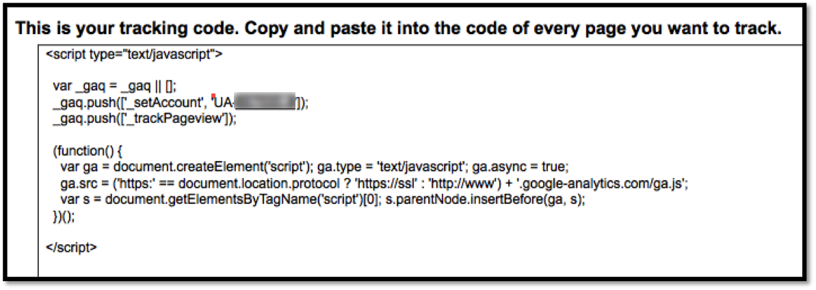
How does Google Analytics Works?
The google analytics works with a small piece of java script code that is made within your analytics account. The account holder generates this code and then places it into the HTML back end of their site. The GA code needs to placed on every page of your website that you want to track.

Slide 5
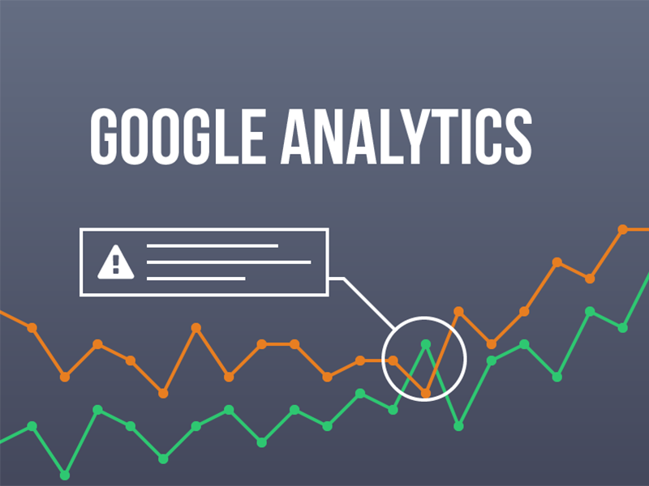
Categories of Google Analytics
Visitors
Advertising
Traffic Sources
Content
Conversions

Slide 6

Benefits of Analytics
Allows for Campaign Tracking
Target your Online Visitors
Evaluation of traffic flow through website
Review Historical data
Customized data reports
Free of Cost

Slide 7

Trends by Google Analytics
It has an important role in Data Security
Deal massive amounts of structured & unstructured data generated by IoT(Internet of Things)
Growth of Cognitive Analytics
In tax Analytics

Slide 8
Creating a Network Google Analytics Account
Create Google Analytics Account.
Click “create an account.”
Set up Google Analytics Tracking ID.
Under the Accounts panel, create a new account.
Select “Website” and “Universal Analytics”/ “GA4”
Fill in your account and web property information.
Select your Data Sharing Settings, and click “Get Tracking ID”

Slide 9

Steps involved
Create Google Analytics Account
1. If you are new to Google Analytics, click on the link to “sign up for Google Analytics” or access http://google.com/analytics.

Slide 10
2. Click “create an account.”

Slide 11
Set up Google Analytics Tracking ID
Once you have created a Google Analytics account, you’ll need to create a tracking ID for your network.
1. In your Google Analytics account, click the Admin dashboard.

Slide 12
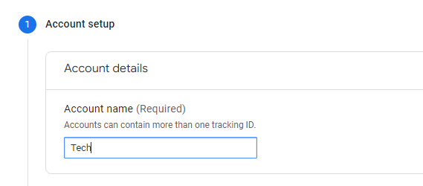
2. Under the Accounts panel, create a new account.

Slide 13
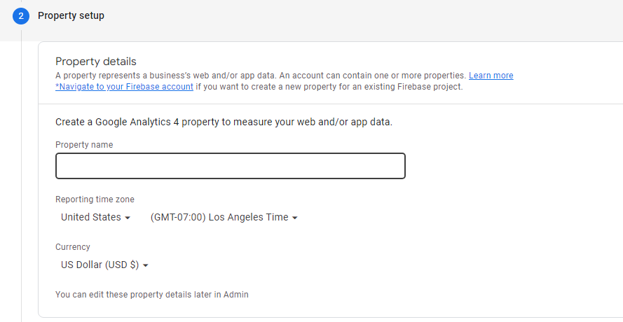
3. Create Property

Slide 14
4. Fill in your account and web property information.
Multiple website properties can be associated with one account name.
The Website URL will be the main URL of your CampusPress network – ie. blogs.myschool.edu
Leave “Default page” field blank otherwise it will break some statistics inside WordPress

Slide 15
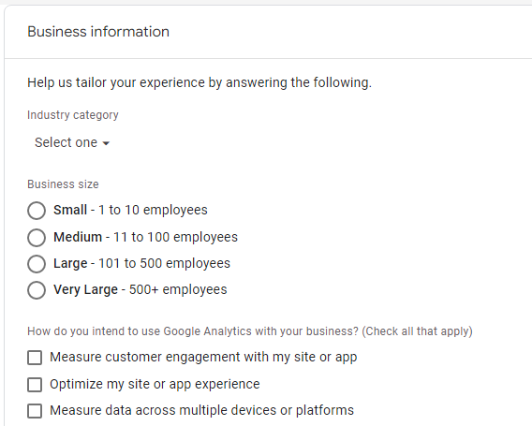

Slide 16
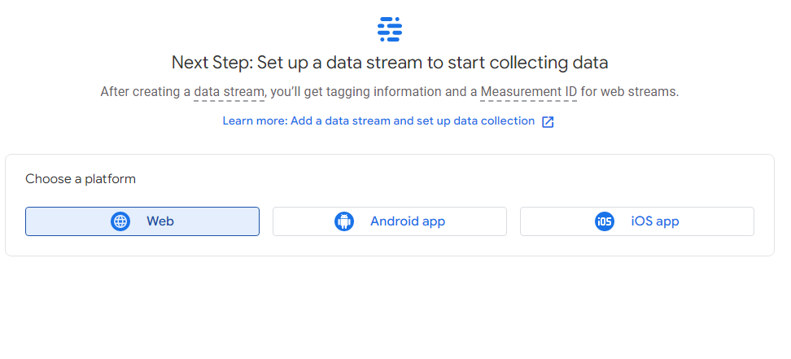

Slide 17
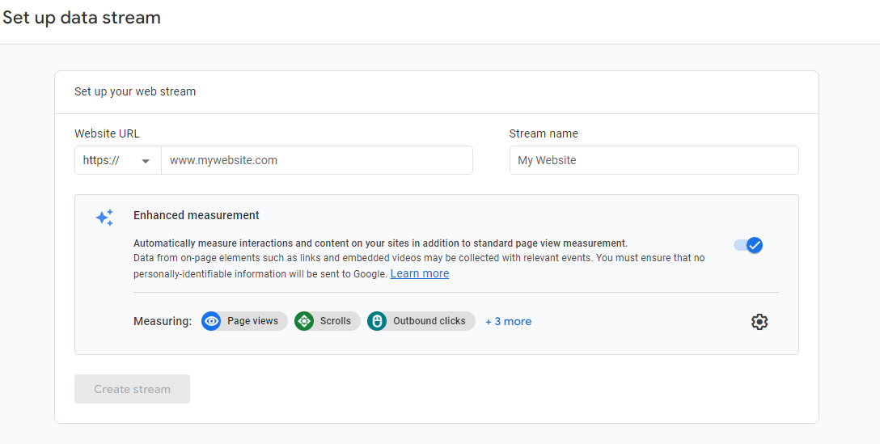

Slide 18
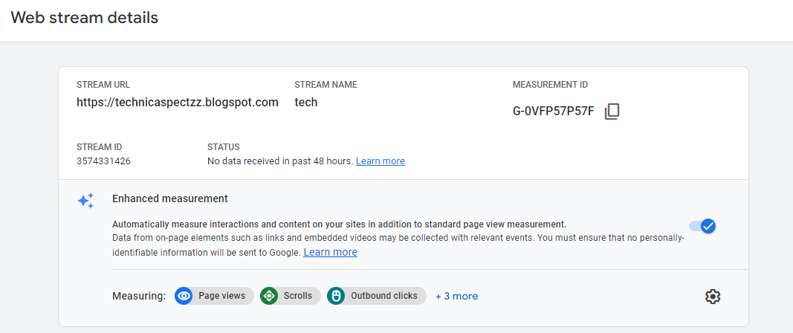

Slide 19
Thank You
Thank You

